Slide 1

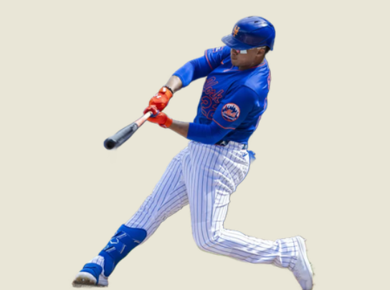
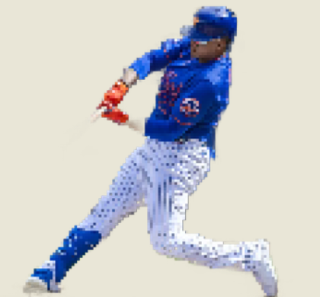

Predicting MLB Playoff Outcomes with Neural Networks
Predicting MLB Playoff Outcomes with Neural Networks
By Matthew Ventura
By Matthew Ventura
PRESS START
Notes:
Would like to add Mets logo/grapic and Grimace

Slide 2
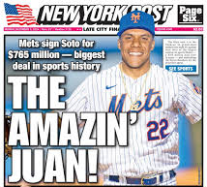

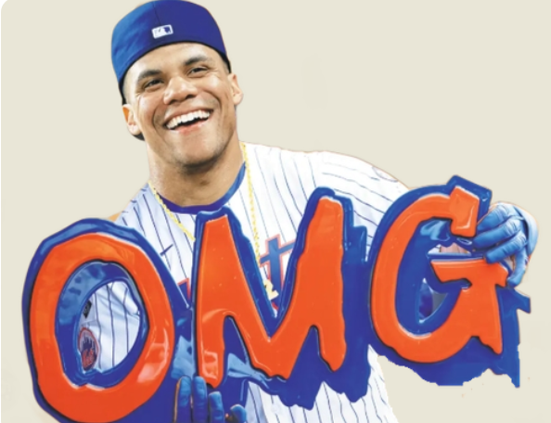
Why Predicting Playoffs Matter More Than Ever
Why Predicting Playoffs Matter More Than Ever
Record-Setting $765 million deal
Arguably one of the top hitters in the MLB
His arrival shifts expectations from fans, front office,& even betting markets
But how can his true value to a team be quantified
How many wins is he worth?

Slide 3
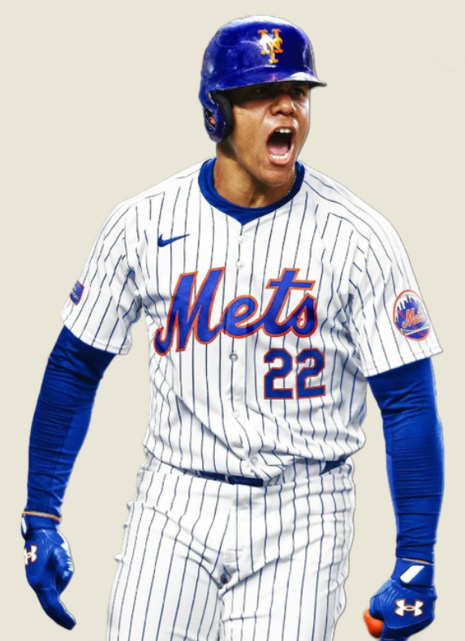
Project Goals
b
.989 OPS
Project Goals
.419 OBP
41 HR
Build a Neural Network that predicts playoff probability in the NY Mets given their sighing of megastar Juan Soto
Compare the 2024 Roster for 2024 NY Mets both with and without Soto to quantify his production mathematically
Integrate historical team data from between the years 2000-2024 (there is reason behind this selection)
Begin to understand patterns and have code make accurate justified predictions based off real baseball sabermetrics
.288 BA
109 RBI

Slide 4

Flow Chart: Neural Network Predicting Mets Playoff Odds
Data Collection
(offense,pitching, defense, playoffs)
Flow Chart: Neural Network Predicting Mets Playoff Odds
Data Cleaning
+ Merging, filling gaps, standardizing names
Feature Engineering
(17 Advanced Team-Level Stats)
Model Training
Neural Network (3 layers)
Prediction
(2024 Mets with and w/ Soto)
Visualization
(Charts + Custom flow diagrams)
Presentation
(Mugridge Symposium on Mets Opening Day)

Slide 5
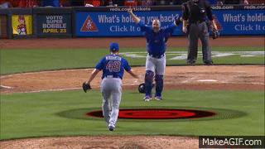
Data Collection
Data Collection

Slide 6
Sabermetrics Used on Neural Network
Sabermetrics Used on Neural Network
Offensive (Batting) Metrics
war – Wins Above Replacement (overall player value)
pa – Plate Appearances
hr – Home Runs
r – Runs Scored
rbi – Runs Batted In
bb% – Walk Rate (% of plate appearances resulting in a walk)
k% – Strikeout Rate (% of plate appearances resulting in a strikeout)
iso – Isolated Power (SLG - AVG, measures raw power)
avg – Batting Average
obp – On-Base Percentage
slg – Slugging Percentage
woba – Weighted On-Base Average
wrc+ – Weighted Runs Created Plus (adjusted for park and league)
Defense Metrics
def – Overall defensive value (Fangraphs)
rtot – Total Zone Runs (fielding range/positioning metric)
def runs saved – Defensive Runs Saved (how many runs a player saved)
Baserunning
bsr – Baserunning runs (how many runs contributed via baserunning)
Pitching Metrics
era – Earned Run Average
whip – Walks and Hits per Inning Pitched
defeff – Defensive Efficiency (team's ability to convert balls in play into outs)
off – Offensive runs above average (Fangraphs-calculated)

Slide 7

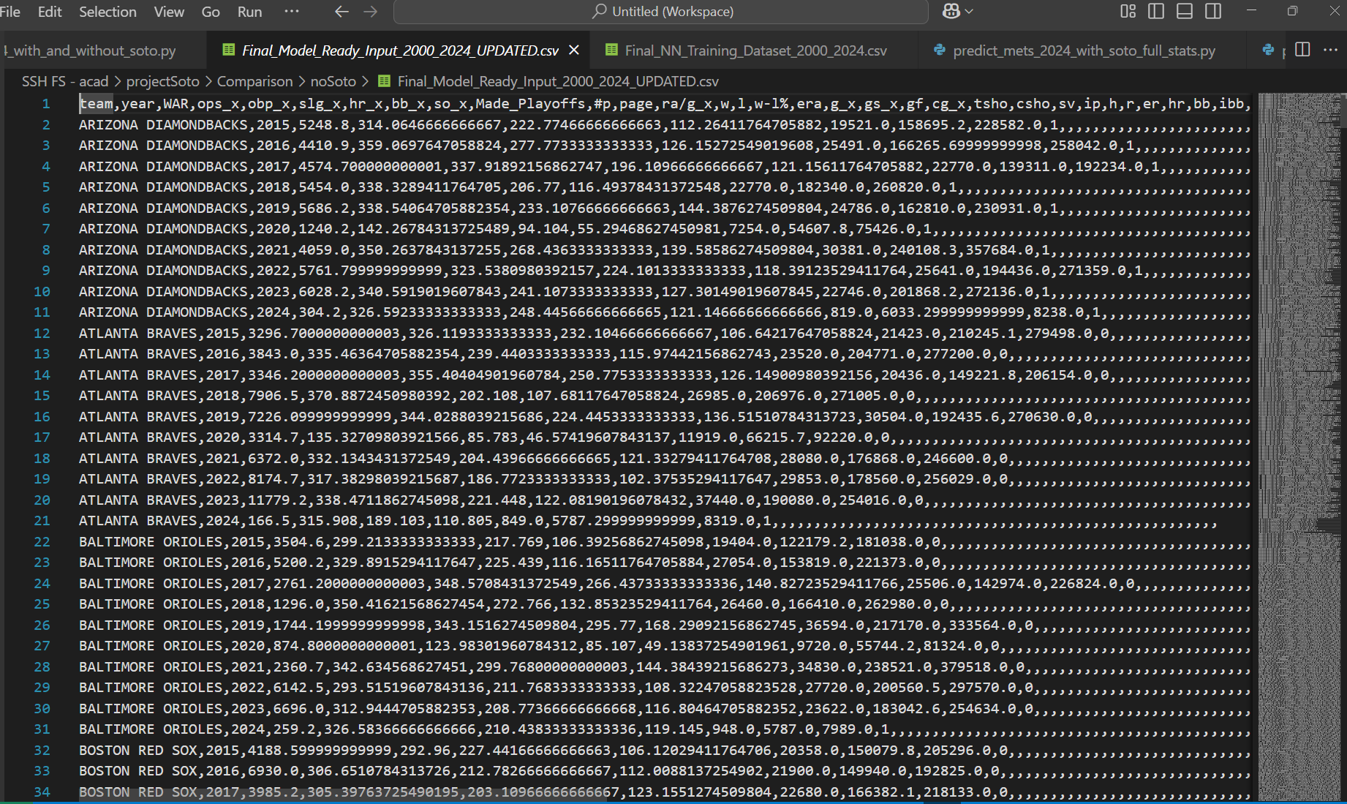

Process for Data Collection and Features
Process for Data Collection and Features
Found appropriate sites with credible sabermetrics across all 30 MLB teams (credit: Kaggle, Baseball Reference, MLB)
Merged datasets together (Advanced Statistics, hitting, fielding, pitching) into one compiled spreadsheet that was used for training
Cleaned and Standardized over 25 key sabermetrics used in player/team evaluation (reason for this number)
Final Data-set consisted of over 7500 rows, 20+ features over the course of full 162 game seasons dating back to the year 2000

Slide 8

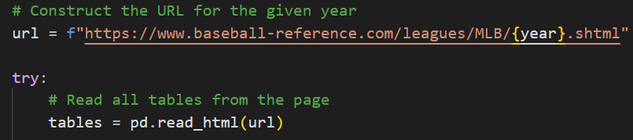
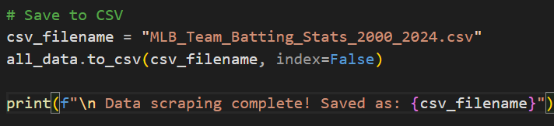
Web Scraping For Data
Web Scraping For Data
Strategy:
Used loops to iterate through tabs from 2000 to 2004 by dynamically changing URL
Parsed out relevant tables by targeting HTML <table> tags with class names/ID’s

Slide 9
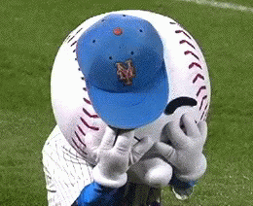
Limitations
of data
b
Limitations
of data
b
Some advanced sabermetrics (DRS, and RTot) were only consistently recorded prior to 2015
Consistency was maintained using teams league average
Slightly reduce outliers in previous seasons

Slide 10

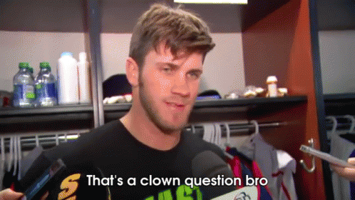
First of all…
What IS a Neural Network?
First of all…
What IS a Neural Network?

Slide 11
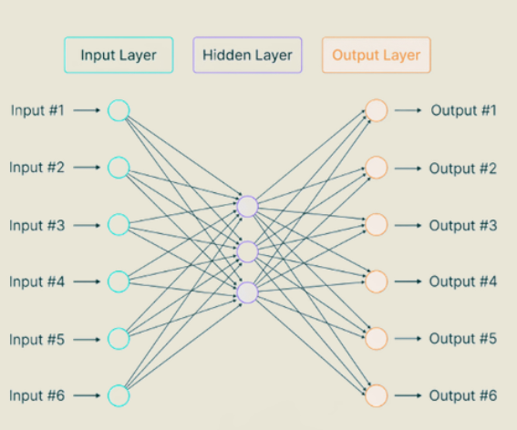

What is a Neural Network (And why use one)
b
What is a Neural Network (And why use one)
Neural Networks are ML (machine learning) models inspired by the human brain as it mimics its structure, and processes to learn information
In place of normal neurons in the human brain, the network consists of nodes which have many layers (some for input some for output)
It learns from pattern seeking and from LOTS AND LOTS of data. In our scenario predicting whether a team will make the playoffs
Models complex data and their relationships
Learns from past MLB Seasons (2000-2024) to generalize future outcomes

Slide 12
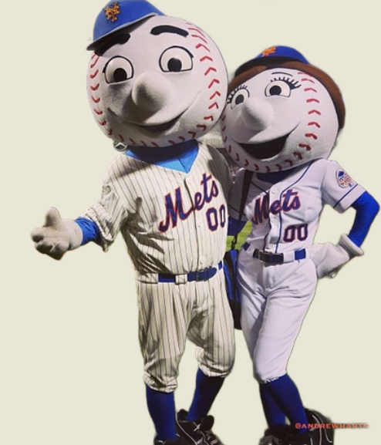

Input Layer
(team stats)
Hidden Layer 1
(computes weights & processes data
64 neurons)
Hidden Layer 2
(computes weights & processes data
Drops to 32)
Output Layer
(takes processed data & decides probability)

Slide 13
Strategies Implemented In Neural Network–Early Stopping
Strategies Implemented In Neural Network–Early Stopping
b
-Quits training the model if it stops improving (also prevents overfitting)
-monitors validation and loss
- it doesnt let the model train too long and memorize data

Slide 14
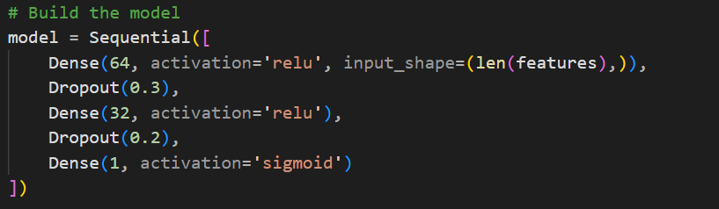

Strategies implemented in Neural Network–Activation Function
Strategies implemented in Neural Network–Activation Function
Helps Network display non-linearity that causes overfitting in data
Useful when you need diverse predictions

Slide 15
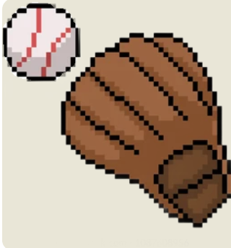
How does the Neural Network process the data and compute?
How does the Neural Network process the data and compute?
b
Formulas: z=w₁​x₁​+w₂​x₂​+⋯+w_{n}​x_{n}+b
a=ReLU(z)=max(0,z)
Where: x_{i} = input features (like WAR, SLG, etc.)
w₁​ = learned weights
b = bias
z = weighted sum
a = activation output
KEYNOTE:this is done for every neuron in every hidden layer!

Slide 16
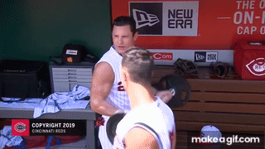
Training Process
b
Training Process

Slide 17
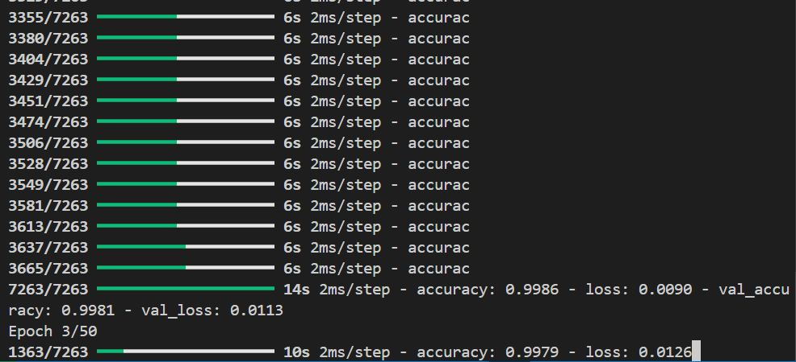
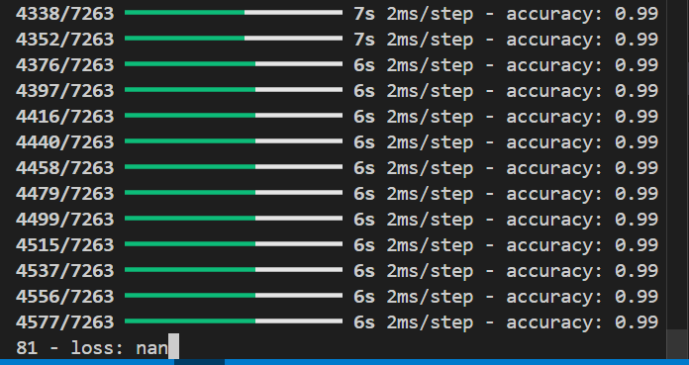
Training performance
Training performance
Accuracy was pivotal in determining success of training
Cleaned and merged Data sets yielded best results in training
Trained on data from 2000-2024
Overfitting error due to 100% Accuracy
NaN (Not a number) error when column value not found

Slide 18
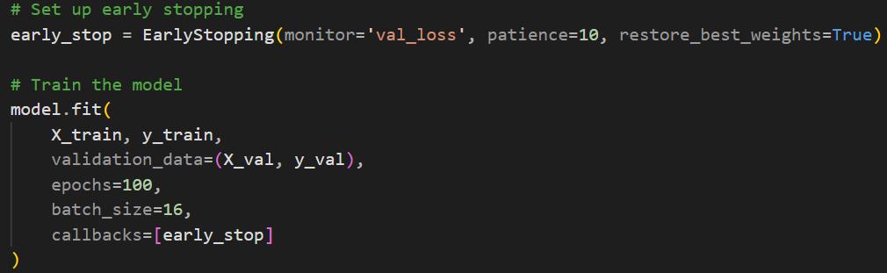
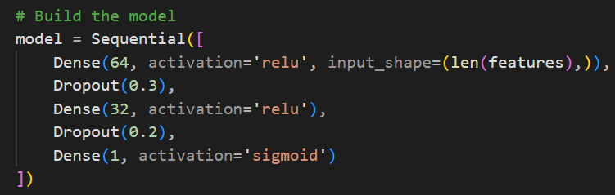
Stabilization of the Learning Process
b
Stabilization of the Learning Process
Reduced Learning Rate
-slowed down how fast the model updated weights
-reduced large fluctuations in training
Reduced # of epochs
- prevented overtraining (leads to overfitting)
- model stops after 10-15 epochs max
Dropout regularization
-as mentioned earlier dropped neurons by 20-30%
-improved generalizations over small data sets

Slide 19
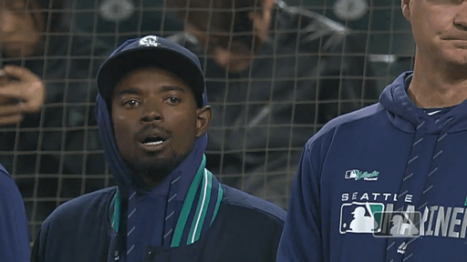
WAR ≠ Everything
WAR ≠ Everything

Slide 20
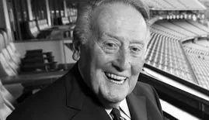
As the famous commentator Vin Scully stats…
As the famous commentator Vin Scully stats…
“Baseball Stats are like light-posts,
They provide definite support but they do not illuminate”

Slide 21
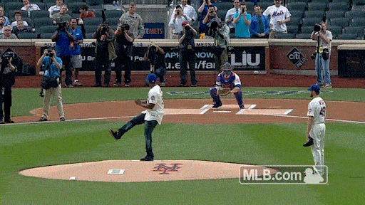
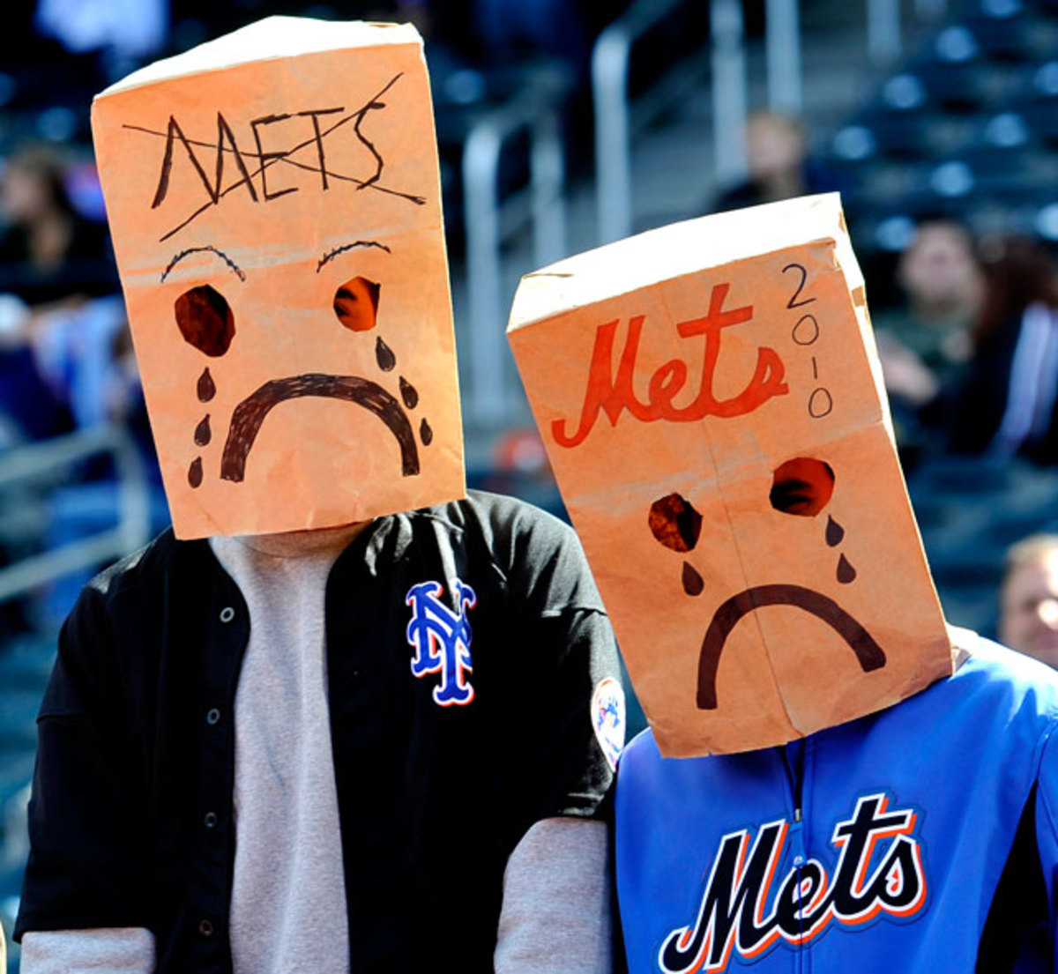
Sabermetrics are not Perfect…
b
Sabermetrics are not Perfect…
Sports are sports…they can be unpredictable
Sabermetrics and stats do not tell the whole story of a team's success as other factors do come into play
(injuries, underperformance,
Numbers tend to not tell the whole story–teams can go through hot and cold streaks in a 162 game season.
*I should know as a lifelong mets fan 2010-2014 were horrendous, bro what if they know absolutely JACK about baseball
strength of schedule etc)
Notes:
should know as a lifelong mets fan 2010-2014 (put 50 cent gif under paper bag image)

Slide 22
Outliers (Case Study 1)
Outliers (Case Study 1)
Case Study: - 2021 Season
The Toronto Blue Jays had a team WAR of ~42.6
The Seattle Mariners had Team War ~24.6
The WAR alone portrayed a 18 win difference
Actual Win totals: Toronto won 91 games, Seattle won 90 games
What this highlights:
War correlated with success, however it isn't always perfect
Strength of schedule, bullpen versatility, and clutch factor are not captured in WAR
Clear example of how statistics/sabermetrics can greatly oversimplify team performance over the course of the regular season

Slide 23


Outliers (Case Study 2)
Outliers (Case Study 2)
b
Case Study 2024 Season:
Minnesota Twins
-Team WAR ~17.0
- Record 82-80
Texas Rangers
-Team WAR ~20.7
- Record 78-84
What this highlights:
Higher WAR does not guarantee more wins
Other factors play a massive role (clutchness, bullpen stability, SOS in division)
-Key Takeaway: WAR alone cannot independently determine seasons outcome

Slide 24
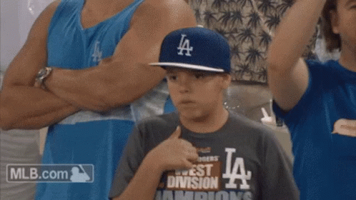
Now…
For the moment of truth…
Now…
For the moment of truth…
b

Slide 25
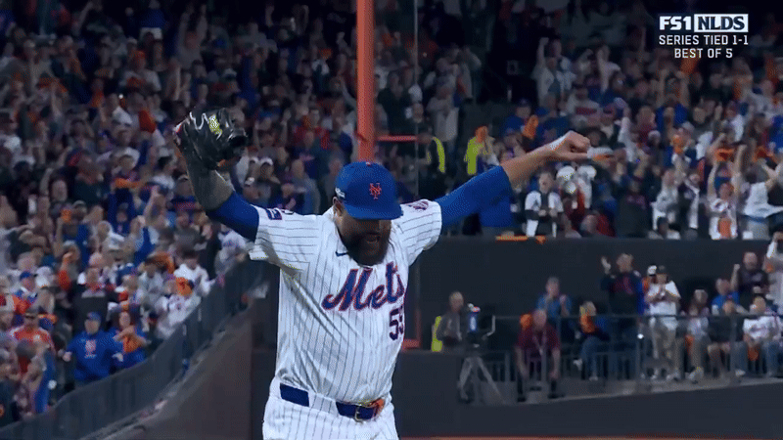
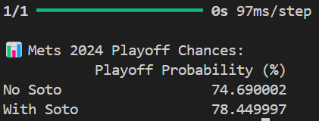
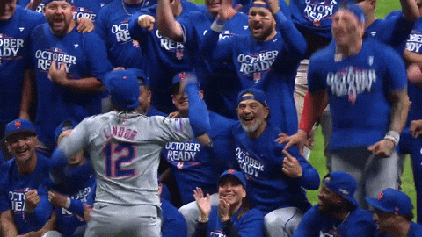
Model Accuracy Recap
Model Accuracy Recap
Training Accuracy: ~80%
Validation Accuracy: ~77-79%
Ensures no overfitting of data
Model actually recognized
patterns.Did not memorize!

Slide 26
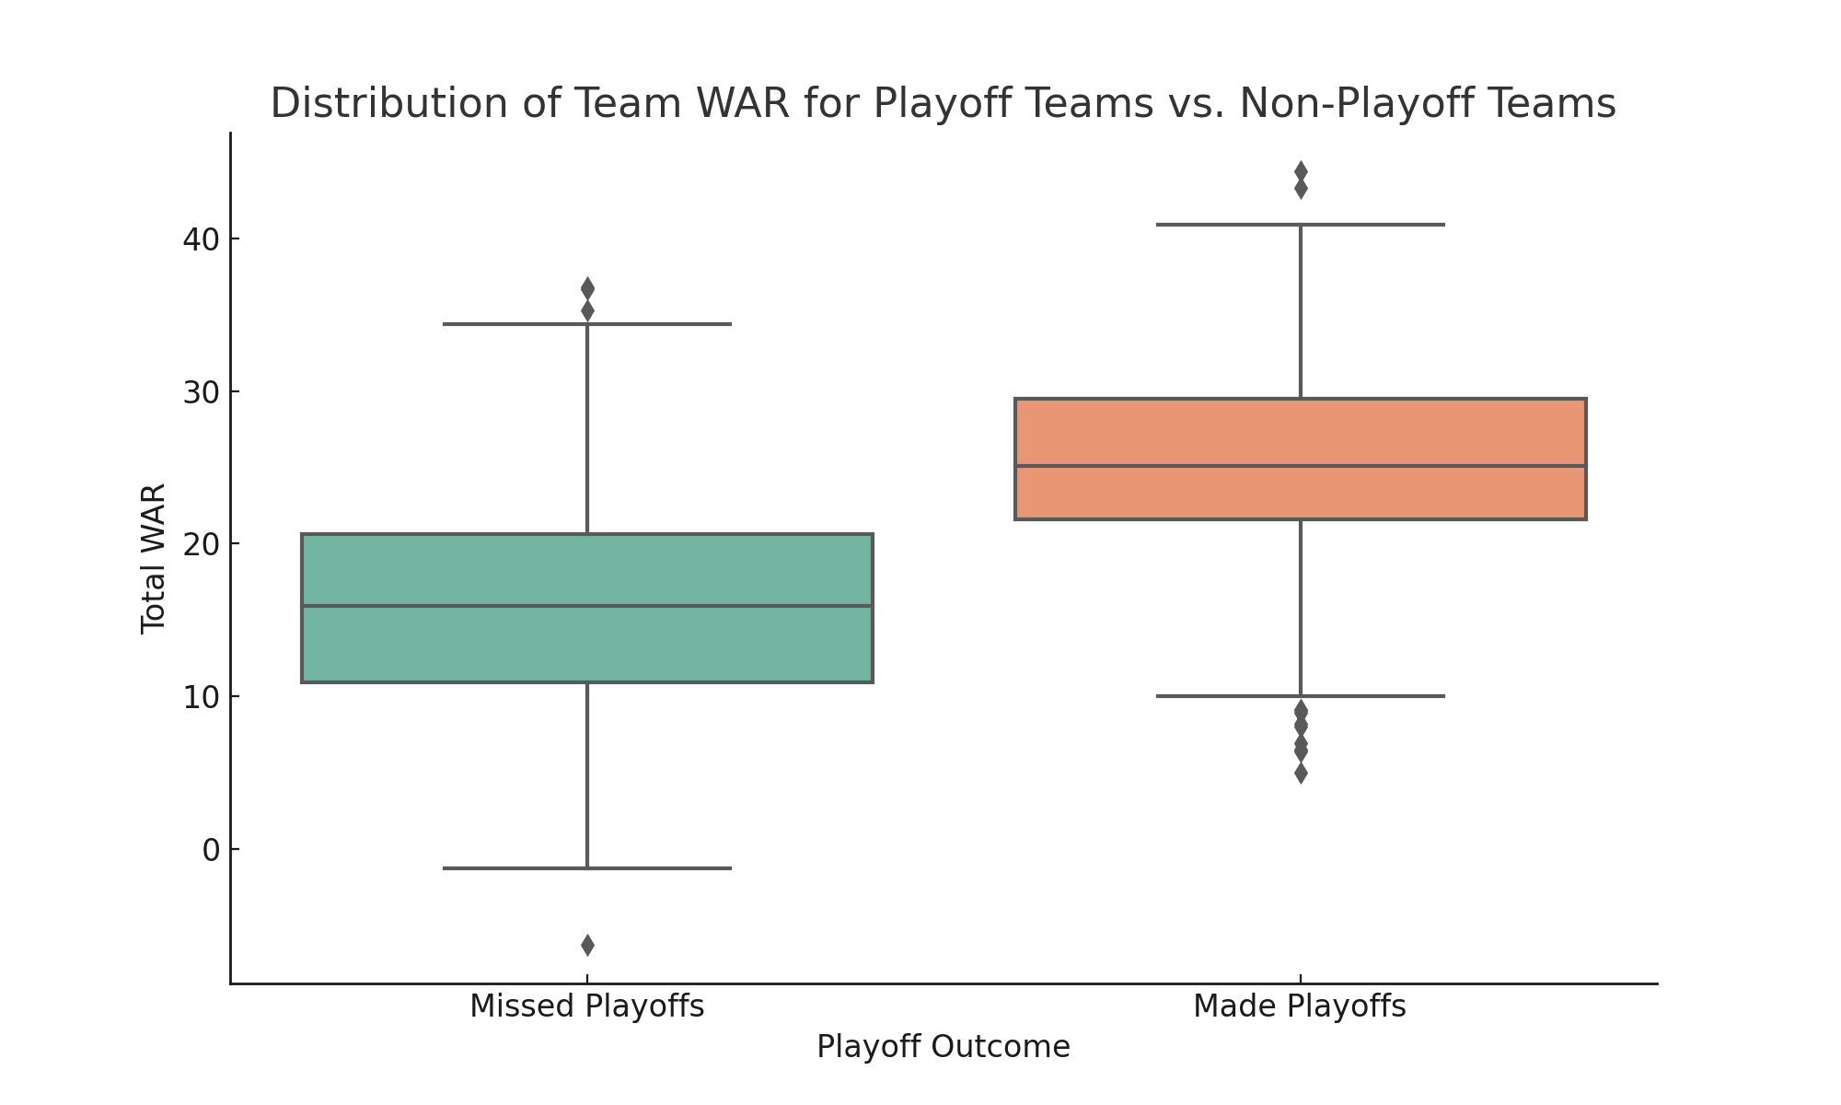
Teams with Higher WAR
make playoffs more often
b
Teams with Higher WAR
make playoffs more often

Slide 27
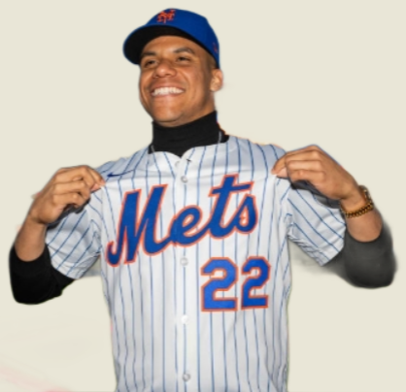
Final Conclusions and takeaways:
Final Conclusions and takeaways:
Juan Soto ALONE increases the playoff percentage by ~4%
Shows an accurate depiction of a player who will significantly make immense impact, yet does not overtake the model significantly
WAR matters but its not everything on teams for determining regular season success
A Machine Learning Model gives a team scalable tools used to measure/simulate roster moves and assess playoff probabilities, this helps front offices
Notes:
Can you make this flow chart pretty

Slide 28
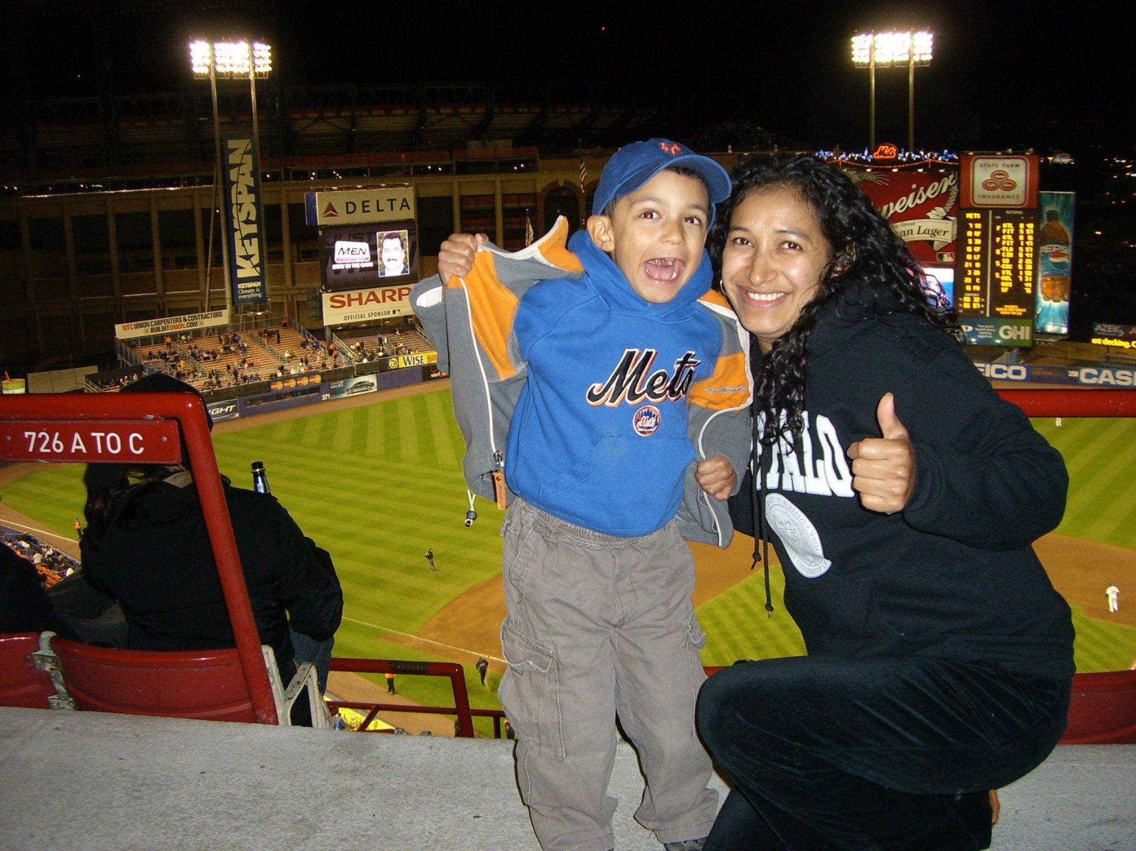

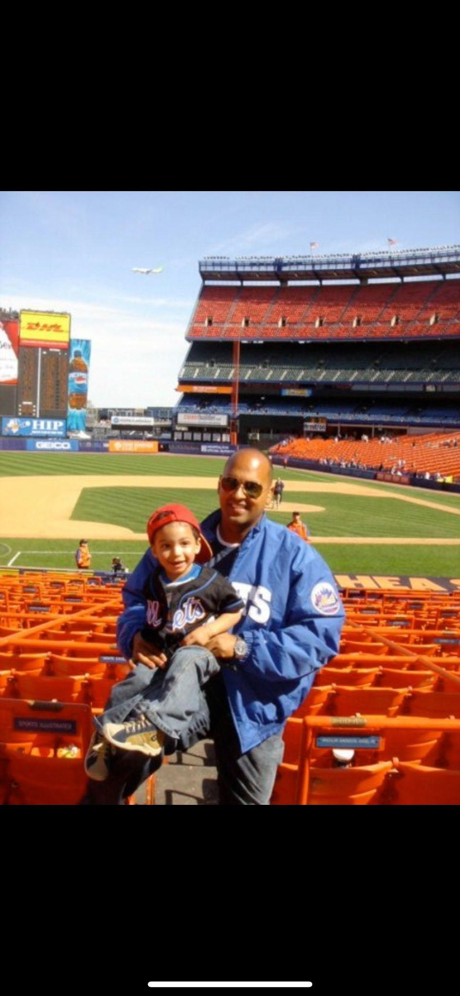
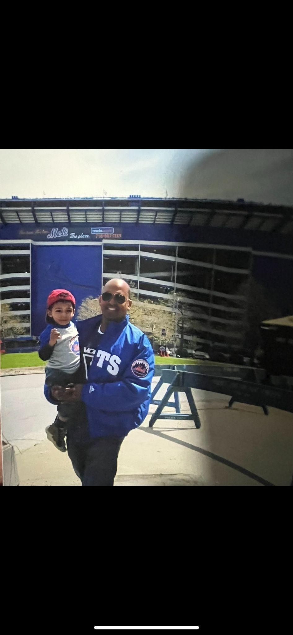
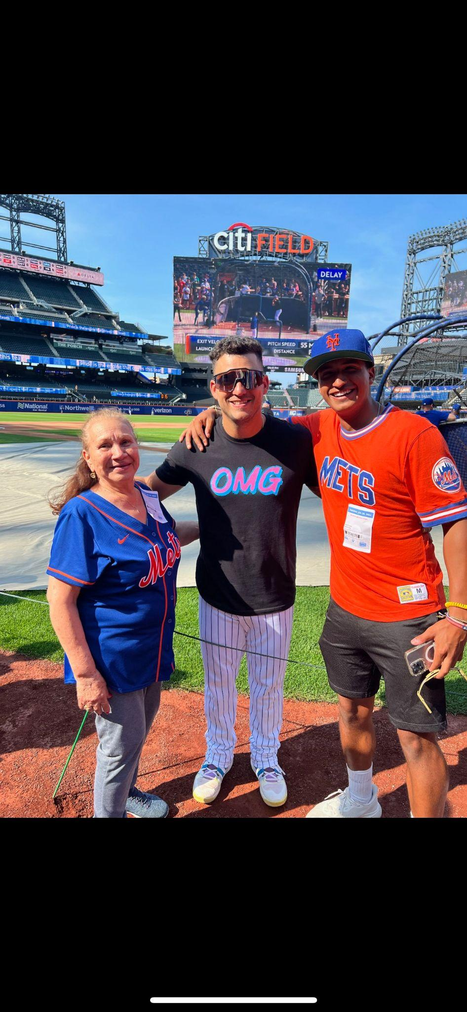


Slide 29

b
GAME OVER

Slide 30



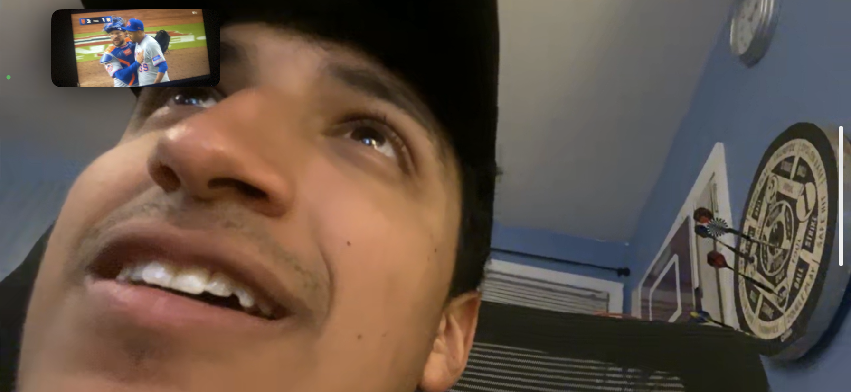
I don't know when you'll see this or even if you ever will, but in the off chance you do. I just wanted to go back and add a slide showing the aftermath and just tell you how proud I am of you. You went up there like you owned the place and left like you did too. You were a natural. Every word that came out of your mouth had me falling even MORE in love with you (which is crazy to say bc i mean c'mon i already love you to the max.) But you are an actual genius Matt. Not only that but the way you carry yourself and can change the mood of any room is just so attractive, wow. Don’t ever ever ever doubt yourself. I'm not just saying this,but you can truly do anything you put your mind to. Words cannot describe how proud i am of you. We walked decked out in all mets, and had a lot of stares and laughs, but i wouldn't do that with anybody else. Who would've thought that a neural network would make me look at you in such a new way. I love everything about you and I would love to spend the rest of my life decked out in mets with you. I am more than with that. As long as it's with you. But srsly bro you when up there and took everyone's breath away.ik nate lowkey sharted himself when he saw what you were bringing to the table. “poor is the pupil who does not surpass his master.” thats what was going through his mind. And you did just that. We will show our kid this presentation and force them to listen to me yap about how i fell even harder in love with their father on this day.mark my words i will never forget this. I am so unbelievably proud of you and i can't wait to be by your side for the next one.

